Slide 1

Exploratory Data Analysis
Cab Industry Case Study
Amshumann Singh
Date: 2nd August 2021

Slide 2

Agenda
Problem Statement
Understanding the Data
Data Exploration
Summary Statistics
Graphical Analysis
Observations and Recommendations

Slide 3
Problem Statement
XYZ is a private equity firm in US. Due to remarkable growth in the cab industry in last few years and multiple key players in the market, it is planning for an investment to the same.
Objective : Provide actionable insights to help XYZ firm in identifying the right company for making their investment.
The analysis has been divided into parts:
Understanding the Data
Data Exploration
Summary Statistics
Graphical Analysis
Recommendations

Slide 4
Understanding the Data
There are 4 individual datasets which have been used to analyze how two cab companies have been faring in the industry. The data provides information regarding each trip being taken, the revenue it generates, the costs and the hold on the market the companies have in different cities.
The 4 datasets are:
Cab_data.csv: Contains details for every transaction
City.csv: Incorporates information regarding the cities the cab companies run in.
Customer_ID.csv: Includes information about the customers using the cab services.
Transaction_ID.csv: Contains payment information for each transaction.
The Cab data and City datasets are merged on the City column, the Transaction ID dataset is merged on the Transaction ID column and the Customer ID dataset is merged on the Customer ID column which was previously integrated with the Master dataset (Transaction ID dataset).
The Master dataset has 21 features with 359,392 datapoints. The number of derived features are 5. The time period during which the data has been recorded is: 2nd Jan 2016 to 31st Dec 2018.

Slide 5
Merging for the Master dataset
Master Dataset
Customer ID Dataset
Transaction ID Dataset
Cab Dataset
City Dataset

Slide 6
Data Exploration
Feature Transformation:
The serialized date values have been converted to datetime and then splice to get month, day of week and year values for each transaction.
Profit/km has been calculated for each transaction and used as a feature.
Ratio of cab users to the population has also been calculated to understand how popular cabs are in the city.
There are no Nan values or duplicates in any of the datasets. There might be some outliers in terms of the cost of the trip or the price charged, but as there is no information about the duration of the trip, these datapoints have been considered in the analysis
Assumptions made:
Pink Cab and Yellow Cab have been identified as the two companies that firm is considering to invest in.
There’s been no cab strike or closure of taxi transport during the time period the data was recorded in.
The taxi service is within the city and does not go from one city to another.
Profit/km is calculated as (Price Charged-Cost of trip)/Distance Travelled

Slide 7
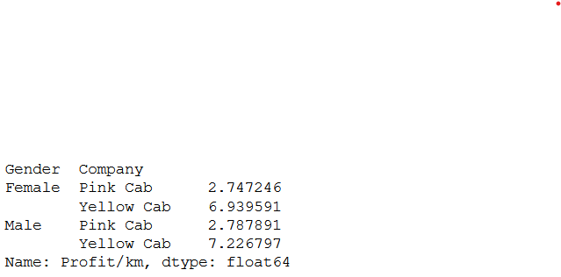
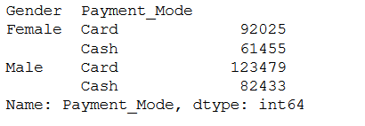
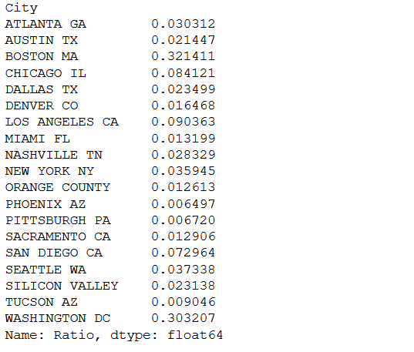
Summary Statistics
Looking at the Profit/km statistics for the two companies, we can see that for both male and female customers, Yellow cab is clearly more profitable compared to Pink cab. Male customers are slightly more profitable for Yellow cabs but its insignificant.
Another important observation here is that more cab users make payments by card rather than cash. There is scope for utilizing this information to incentivize card usage as more people are leaning towards that payment mode.
Cities like Washington DC, Boston and Los Angeles have the highest cab users to population ratio. These are the 3 cities which have a higher number of cab users and taxis are an important form of transport. Thus the firm should target these cities to establish themselves in the cab market.

Slide 8
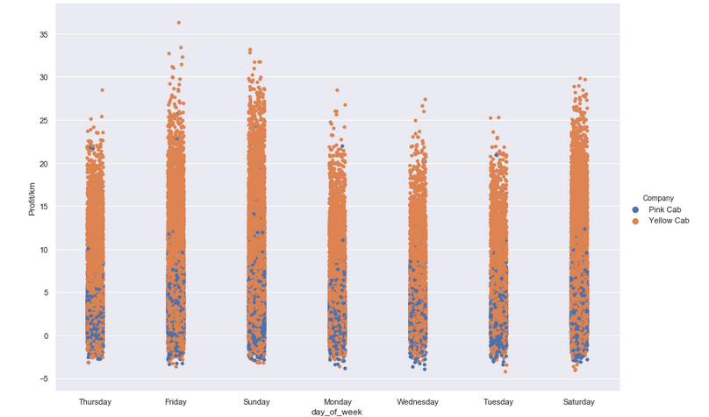
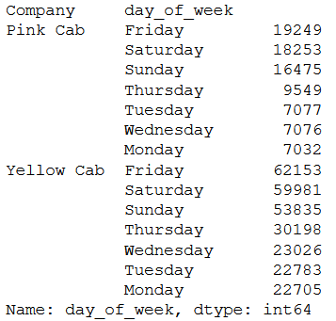
Graphical Analysis I
Observing the days of the week, we can see that Yellow Cab has the more profitable rides compared to Pink Cab. Another thing we can observe here is that the actual number of rides is much higher for Yellow cab.
The days with the most profitable rides are Friday, Sunday and Saturday. The reasons for that could be that longer rides and longer waiting times occur more frequently on weekends. Monday, Tuesday and Wednesday are the least profitable. Even the number of rides are less on these days.

Slide 9
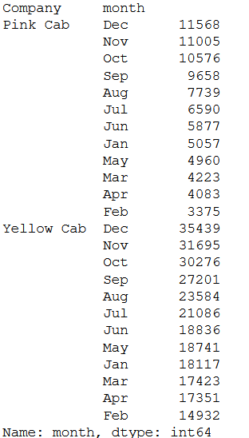
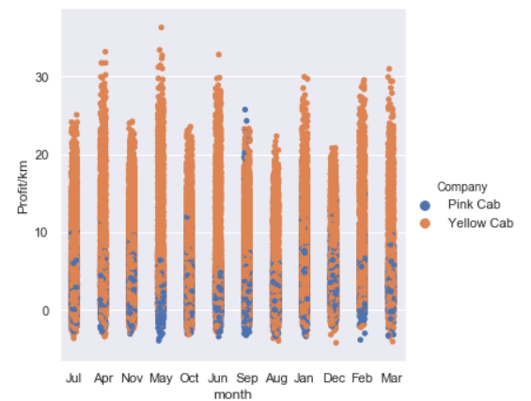
Graphical Analysis II
The months of April and May seem to be the most profitable, maybe due to taxis being hired for day trips. Even tourism would be at it’s peak during these months in most US cities.
Pink cab is again shaded by Yellow cab and doesn’t show any time period where it might be more popular than its counterpart.
The winter months are where the taxi services become more popular. Due to extreme cold in most major US cities, taxi services being used more often makes a lot of sense.

Slide 10
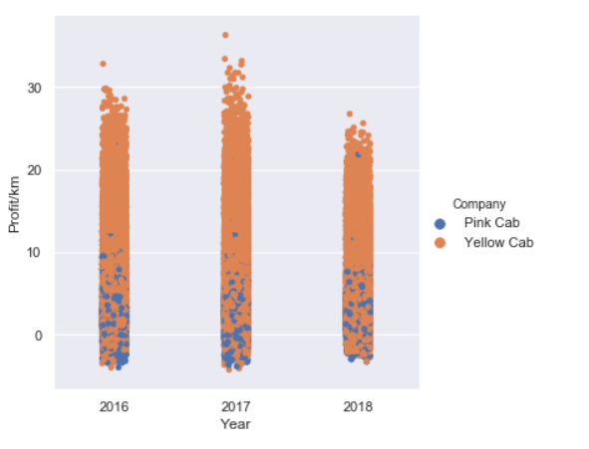
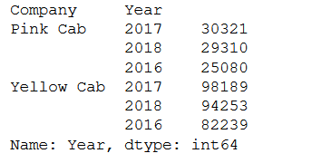
Graphical Analysis III
We can clearly see that the taxi services have an inconsistent profit output year-on-year. 2017 is the peak year, both in terms of number of rides as well as profit generated from them.
The more concerning part from an investment perspective is the slump in numbers seen in 2018. There could be many reasons for this slump. Maybe new taxi regulations have come into effect. Or a new player has entered the market and taken away from both Yellow Cab and Pink Cab’s share.

Slide 11
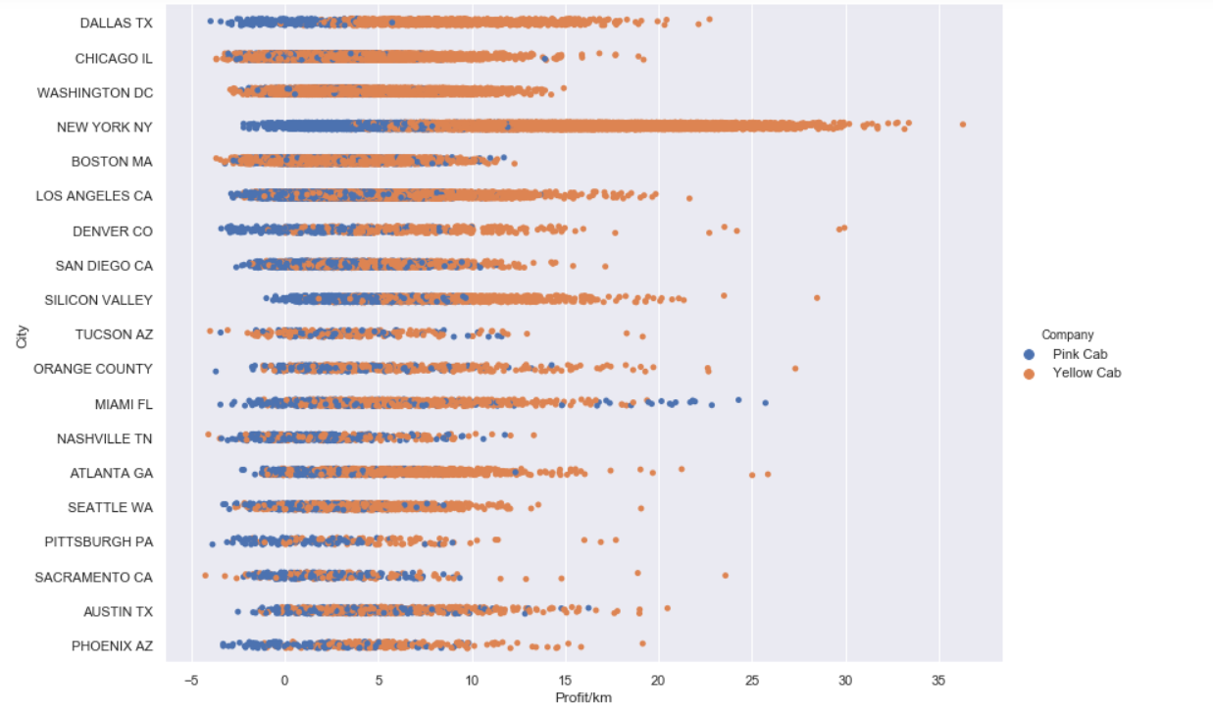
Graphical Analysis IV
New York City is the location that generates the most profit for Yellow Cab. The lower spectrum of profits all belong to Pink cab which indicates that its profit margin is quite poor. This is the case not just with New York City, but also Nashville, Phoenix and Pittsburgh.
Miami is one of the cities where Pink cab actually generates profit through its services. It could be one of the markets where it could experience growth.

Slide 12
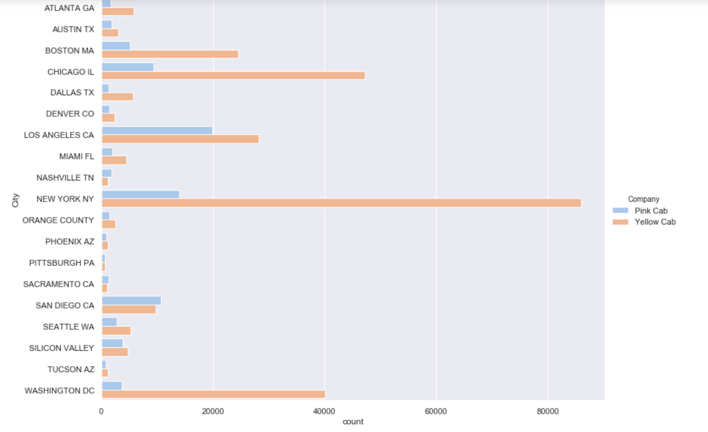
Graphical Analysis VII
Yellow cab is very popular in New York, Chicago and Washington compared to Pink cab. Cities like Nashville, Phoenix and Pittsburgh seem to be places where the two companies have very little traction.
San Diego and Los Angeles seem to be two cities where Pink cab is at least close to being as popular as Yellow cab. California as a state seems to be where Pink cab actually competes with its counterpart. Including Seattle, we see that the West coast of the US is where Pink cab has actually captured a market.

Slide 13
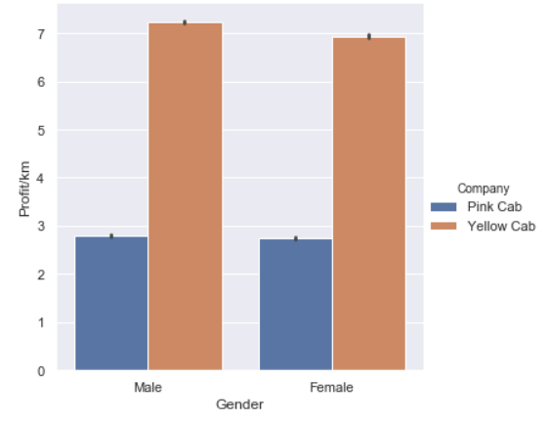
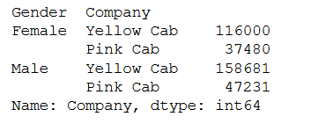
Graphical Analysis VI
Looking at how gender affects the margins of the two companies, we see that it barely makes a dent. There is no indication that gender actually makes a difference to profit margins for either company, though male users do produce a small margin of profit/km over the female users.

Slide 14
Observations and Recommendations
From the analysis that has been conducted on the data that is available, we can conclude the following:
Yellow cab generates more profit on each ride compared to Pink cab. The workflow and the expenses incurred by Yellow cab seem to be more streamlined compared to Pink cab so they’re definitely the better option from that perspective.
Yellow cab is also more established in the market. The number of rides on Yellow cabs are another plane compared to Pink cabs, especially in cities such as New York City, Chicago and Washington DC.
The West coast of the US is where Pink cabs have established themselves more but there are a few issues in them trying to expand there. The main problem is that a majority of the population in these cities own cars, which is not the case in cities such as New York City and Boston, where people are more reliant on public transport.
The winter months is when most rides take place. This is due to other forms of public transport becoming more inaccessible in colder cities. Taxis become a more enticing option to travel in these times. This again gives Yellow cabs another edge.
Cities such as Boston and Washington DC have higher ratio of cab users, making them great expansion markets.
Looking at the overall picture, we can conclude that Yellow cabs is a much better investment opportunity compared to Pink cab.

Slide 15
Thank You

